Slide 1
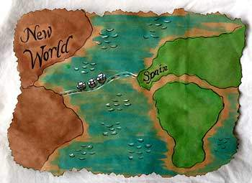
Spanish exploration & settlement in the Americas

Slide 2
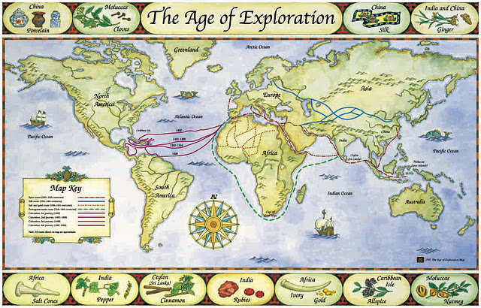
Why explore the World?
GOLD
GLORY
GOD

Slide 3
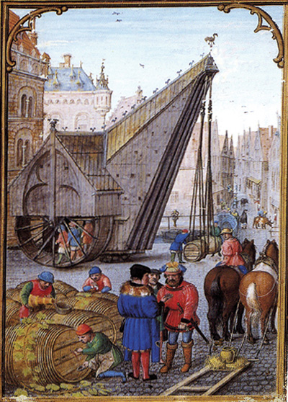
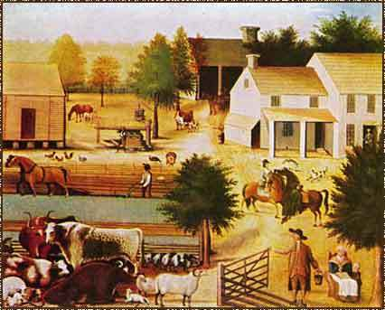
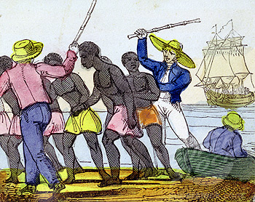
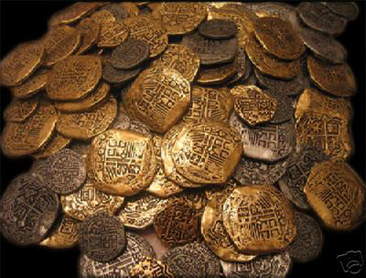
Explore for Gold!
Gain territory
Profit from natural resources
Increase trade in new colonies

Slide 4
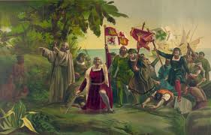
Explore for Glory Explorers hoped to gain GLORY, or fame by leading successful voyages, not to mention a share of the profit.
Christopher Columbus believed he could find a shorter trade route to Asia by traveling west, from Europe, across the Atlantic Ocean.

Slide 5
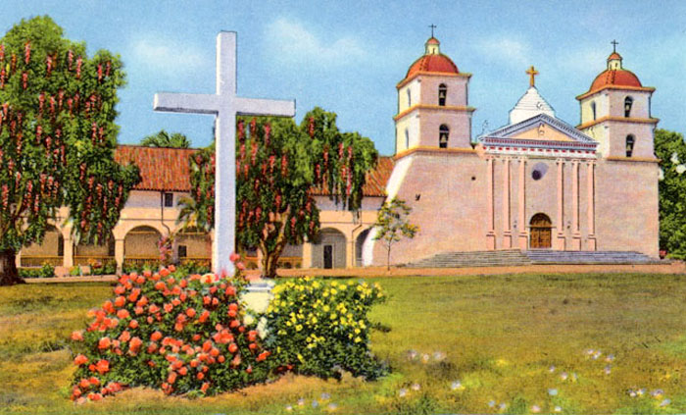
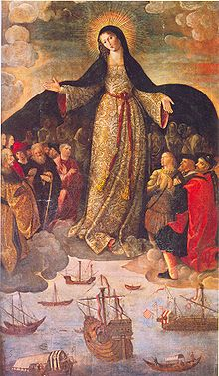
Spread the word of God!
Missionaries spread their religion,
their word of God,
to distant parts of the World.
This also helped nations
gain allies (supporters)!

Slide 6
The search for Asia led to a New World discovery
The King and Queen of Spain wanted to profit from trade with Asia, so they sponsored (helped) Columbus to make four trips across the Atlantic.
Columbus never found a faster route to Asia, but he did claim land for Spain, including land in the West Indies.
The land explored by Columbus was actually part of North & South America, a “New World” discovery to people in Europe.

Slide 7
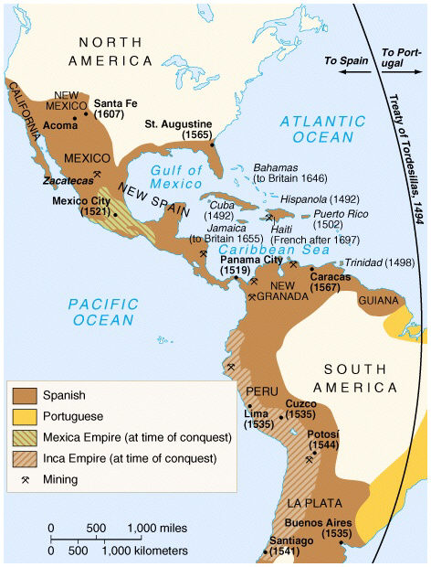
Explorers claimed a vast amount of land for Spain!
Spain established colonies in South America, Mexico,
the West Indies
& across the southern U.S. from Florida to California.

Slide 8
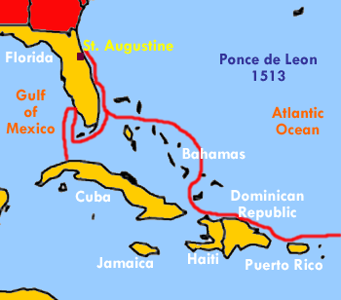
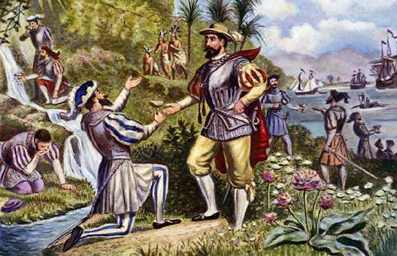
1513- Ponce de Leon explored Florida
His exploration of Florida set the stage for European colonization of North America.
The idea that Ponce de Leon was looking for a Fountain of Youth is actually a myth.

Slide 9
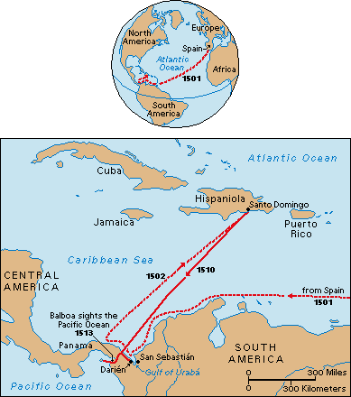
Vasco Nuñez de Balboa “discovered” the Pacific Ocean
In 1513 Balboa claimed the Pacific Ocean & all the land along its shores for Spain.
His expedition opened the way for Spanish exploration and conquest
along the west coast of South America.

Slide 10
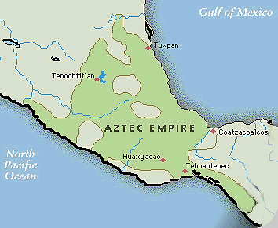
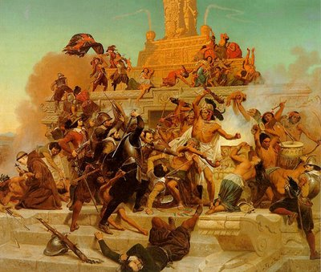
Cortes Conquered the Aztec in Mexico
1519- Cortes and 500 conquistadors conquered the Aztec Empire.
Already weak from European diseases, the Aztec were at a disadvantage.
Indians, angry with their Aztec leader, helped Cortes take over the Aztec capital.
The Aztec capital, Tenochtitlan, was torn down. Its stones were used to build Mexico City, the capital of New Spain.

Slide 11
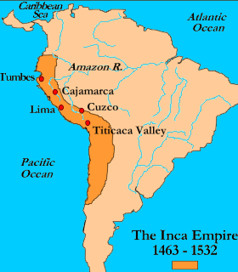
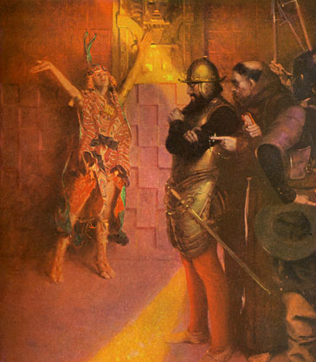
Pizarro Conquered the Inca Empire of Peru in 1531
Francisco Pizarro captured the Inca ruler,
held him hostage, and demanded gold in exchange for his release.
The Inca filled three rooms with gold, but Pizarro ordered the ruler killed anyway.

Slide 12
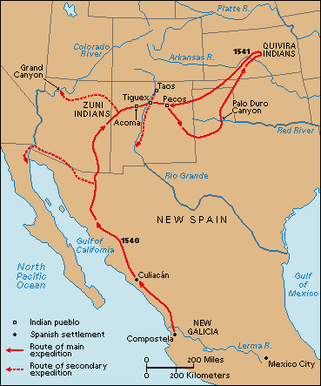
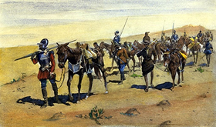
Francisco Coronado searched for the Seven Cities Of Cibola (cities decorated with gold & jewels) in February, 1540
Three important discoveries:
the Grand Canyon
Indian pueblos along the Rio Grande
the Great Plains full of buffalo herds
He travelled with 300 soldiers, 1,000 Indian allies & slaves, several missionaries, and about 1,500 livestock.

Slide 13
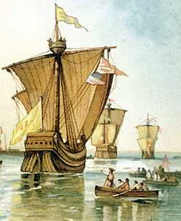
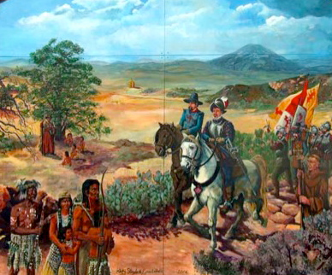
Cabrillo Explored California
June, 1542
Juan Rodriguez Cabrillo
was the first European to
explore the west coast
of the Unites States

Slide 14
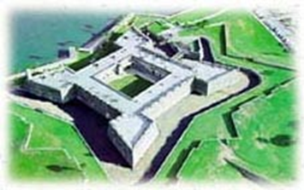
Pedro Menendez de Aviles forced the French out of Florida in 1565.
Aviles was sent to protect the region & establish a colony in Florida.
He had St. Augustine, a presidio, built to protect the region from enemies.
Today St. Augustine is the oldest permanent European settlement in the United States.

Slide 15
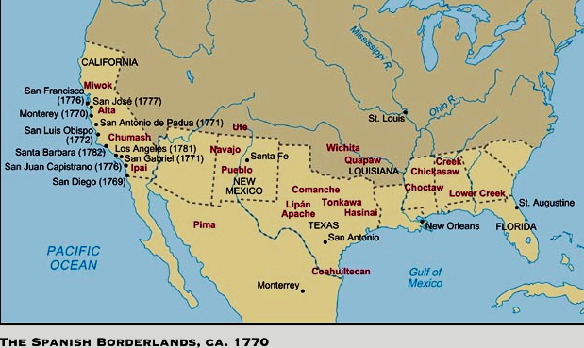
Settlements extend into the “Borderlands”
By the end of the 1770 Spain had pushed north into
present-day Texas, New Mexico, Arizona, and California.

Slide 16
Spanish exploration of the New World triggered the Columbian Exchange
The transfer (movement) of people, plants, animals, and diseases back and forth across the Atlantic Ocean
The effects of the Columbian Exchange were mostly negative for Native Americans.
Diseases
Slavery
Many were forced to change their culture

Slide 17
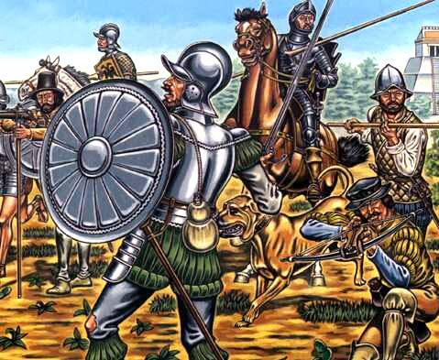
Conquistadors
These soldiers were sent to the New World to conquer the Native American people, claim land, & protect the land Spain took over.

Slide 18
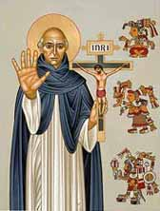
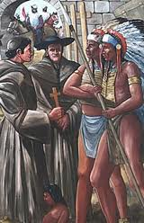
Missionaries
They were sent to teach Native Americans about their religion and way of life.
Teaching Native Americans helped Spain gain supporters, or allies, in the New World.
Some missionaries were cruel and abusive to Native Americans though.
Most believed Native Americans were uncivilized & needed to be saved from their own “savage” beliefs & way of life.
Bartoleméu de Las Casas
1502- travelled to New World
1514- shared his upset over the mistreatment of Native Americans. He spent the rest of his life trying to protect their rights.

Slide 19
Spain controlled its colonies by building different settlements; including presidios, missions, and plantations.

Slide 20
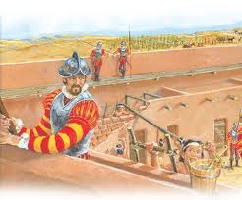
Presidios- military forts used by soldiers protecting Spain’s colonies
They offered protection against:
pirates
hostile Native American tribes
enemy explorers & colonists

Slide 21
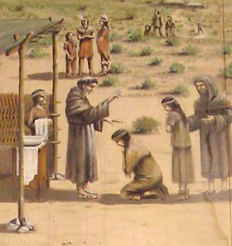
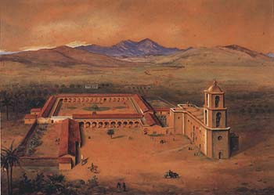
Missions
They included:
a church
workshops
storage rooms
stables for animals
grazing & farmland
living quarters for priests & conquistadors
run by missionaries, as a place to teach a new religion & way of life to Native Americans
also served as military forts

Slide 22
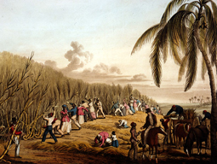
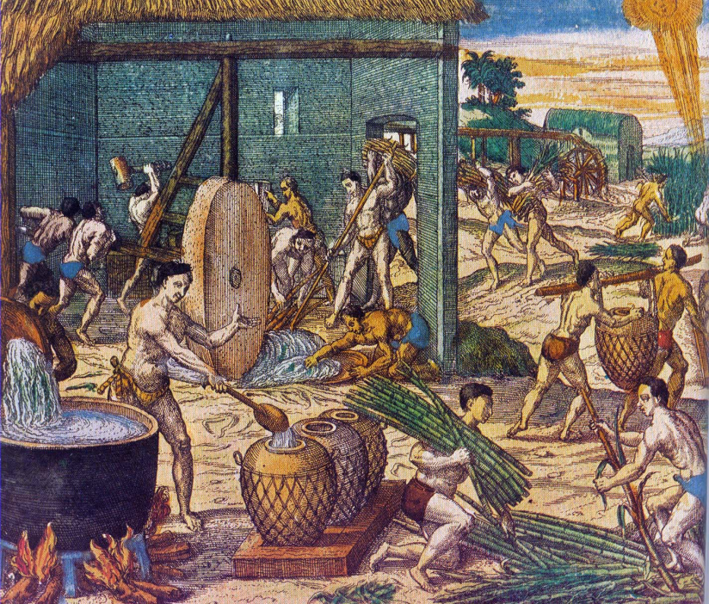
New World Slavery
Native Americans were viewed as property, as part of the land that was claimed by Spanish settlers.
They were forced to:
mine for gold, silver, etc.
process sugarcane
work on plantations,
Many were sold & sent to distant lands, destined for a life of forced labor.

Slide 23
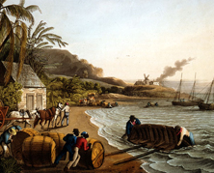
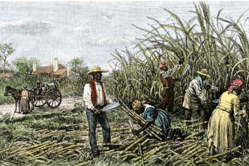
European diseases caused the death of countless native people throughout the Americas.
The Columbian Exchange
Cause & effect
Settlers began importing & using
enslaved Africans
after diseases wiped out
the Native American slave populations.

Slide 24
Each colony provided natural resources and new places for trade, which allowed Spain to gain a great amount of wealth & power.
This motivated other nations in Europe to begin exploring and claiming land in the Americas as well.

Slide 25
Spain led the way, many nations followed!
The unexpected discovery of the “New World” provided new opportunities for nations to gain wealth & more power.
This led nations in Europe to compete over control of the Americas.

Slide 26
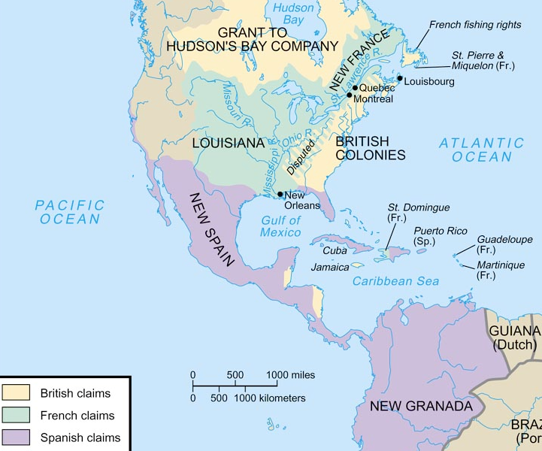
By 1750 France & England were fighting over the land they each claimed in the Americas!
By 1750 France & England were fighting over the land they each claimed in the Americas!

Slide 27
While many Native Americans chose
to be part of the cultural exchange with Europeans…
Some Native Americans welcomed explorers and willingly traded with them.
Some Native Americans saw explorers & settlers as possible allies.
Native Americans were introduced to new goods, foods, and ideas that they enjoyed.
… they were still victims of conquest!
Native Americans homelands were taken over.
Millions of Native Americans were taken as slaves.
Millions died as a result of contact (diseases, warfare, slavery, etc.)
Some tribes were completely destroyed!

Slide 28
Citations
Columbus- First Landing
Library of Congress
http://www.loc.gov
Date retrieved: 11-04-11
Mission
We Are California- Stories of immigration and change
www.weareca.org
Date retrieved: 11-04-11
Overseeing exploration
Wikipedia
http://en.wikipedia.org
Date retrieved: 11-04-11
Exploration map
Shmoop University
http://www.shmoop.com
Date retrieved: 11-04-11
Ponce de Leon map
Vagabond: World Travel/World Life
vagobond.com
Date retrieved: 11-04-11
Legendary waters
Glogster
cheyennelopezwhite.glogster.com
Date retrieved: 11-04-11
“The miraculous waters”
New World Explorers, Inc.
http://www.newworldexplorersinc.org
Date retrieved: 11-04-11
Balboa discovers the Pacific
HowStuffWorks, Inc.
http://history.howstuffworks.com
Date retrieved: 11-04-11
Age of Exploration Map
GS2: American Studies
http://gs2americanstudies.blogspot
Date retrieved: 11-04-11
Explorer bids farewell
Library of Congress
http://www.loc.gov/
Date retrieved: 11-04-11
Port city
Portius
portius.org
Date retrieved: 11-04-11
Farm settlement
AllExperts
en.allexperts.com
Date retrieved: 11-04-11
Slaves at port
SuperStock
superstock.co
Date retrieved: 11-04-11
Gold coins
Great American Coin Company
greatamericancoincompany.com
Date retrieved: 11-04-11

Slide 29
Aztec Empire
University of Calgary
http://www.ucalgary.ca
Date retrieved: 11-04-11
Cortes conquers the Aztec
Painting History
http://painting-history.blogspot.com
Date retrieved: 11-04-11
Inca Empire
University of Calgary
http://www.ucalgary.ca
Date retrieved: 11-04-11
Ransom offered
U.S. History Images
http://ushistoryimages.com
Date retrieved: 11-04-11
Aztec treasures
Discover Peru
www.discover-peru.org
Date retrieved: 11-04-11
Coronado’s route
Albuquerque Official City Website
http://www.cabq.gov
Date retrieved: 11-04-11
Coronado’s expedition
Legends of Kansas
http://www.legendsofkansas.com
Date retrieved: 11-04-11
Cabrillo reaches California
Los Penasquitos
lospenasquitos.org
Date retrieved: 11-04-11
Cabrillo explores California
Villagio at Serrano
villagioatserrano.blogspot.com
Date retrieved: 11-04-11
St. Augustine on the coast
Kiwix
tmp.kiwix.org
Date retrieved : 11-04-11
St. Augustine from above
Palm Beach County History Online
http://www.pbchistoryonline.org
Date retrieved : 11-04-11
Borderlands
Pearson Education
http://wps.ablongman.com
Date retrieved : 11-04-11

Slide 30
Conquistadors
My Direct Democracy
http://mydd.com
Date retrieved : 11-04-11
Presidios
Shamong Township School District
moodle.ims.k12.nj.us
Date retrieved : 11-04-11
Southwest Mission
Wikipedia
http://en.wikipedia.org
Date retrieved : 11-04-11
Missionaries work
Texas Beyond History
http://www.texasbeyondhistory.net
Date retrieved : 11-04-11
Plantation work
National Museum of American History
http://americanhistory.si.edu
Date retrieved : 11-04-11
Processing sugarcane
Florida Museum of Natural History
http://www.flmnh.ufl.edu
Date retrieved : 11-04-11
Cargo to ship
National Museum of American History
http://americanhistory.si.edu
Date retrieved: 11-04-11
Harvesting sugarcane
Art.com Inc.
www.art.com
Date retrieved: 11-04-11
Map: Spain led the way
Pearson Education
http://wps.ablongman.com
Date retrieved : 11-04-11
1750 Map
Pearson Education
http://wps.ablongman.com
Date retrieved: 11-04-11

