Slide 1
Trade With Asia Led Europe To “Discover” a New World

Slide 2
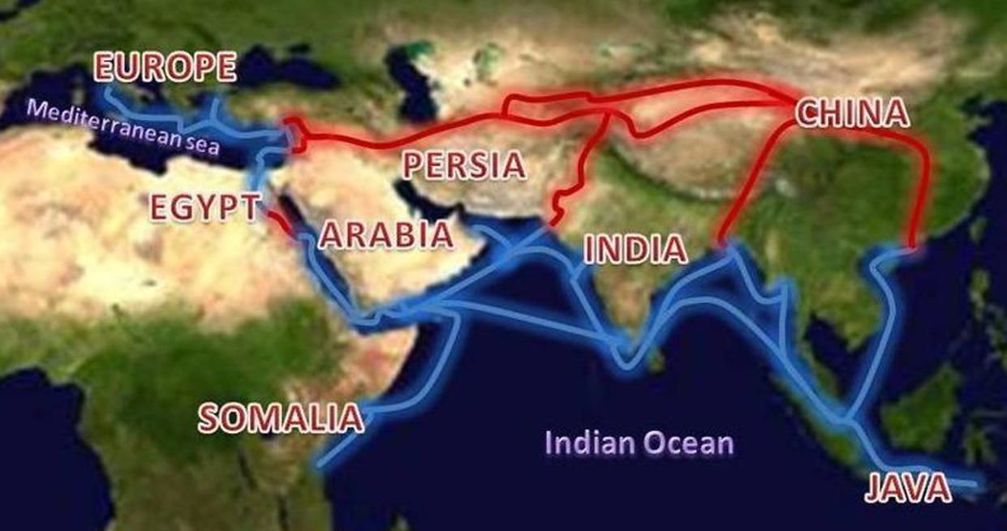
Trade of Asian goods was highly profitable in Europe
Two major trade routes led to the Italian city-states of Venice & Genoa, on the Mediterranean Sea.
Other nations became concerned as Venice & Genoa gained control over the trade of Asian goods in Europe.

Slide 3
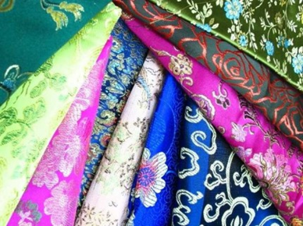
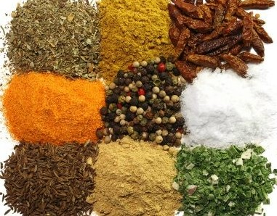
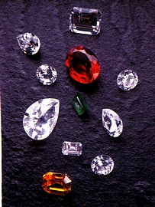
Traders from Asia brought many luxury goods to Europe.
Merchants offered:
Ivory
Gold
Jewels
Silk
Rugs
Spices
Healing herbs
Porcelain tableware

Slide 4
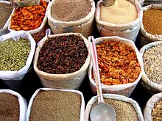
Spices were some of the most valuable treasures that came from Asia.
Without refrigeration food spoiled easily, spices preserved meat & helped cover up the flavor of spoiled meat.
Spices were not affordable to most people. Common ones included:
pepper
cloves
cumin
Worth more than their weight in gold, the most expensive were:
Ginger
Nutmeg
Cinnamon
Saffron

Slide 5
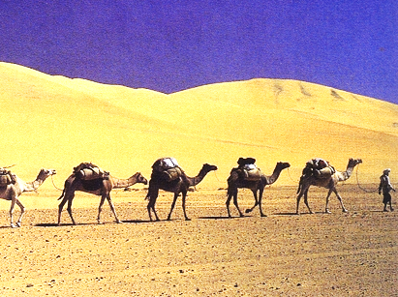
Camel caravans carried many goods between Asia & Europe.
European merchants offered:
Furs
Ceramics
Medicinal herbs
Glass Beads
Horses
Slaves

Slide 6
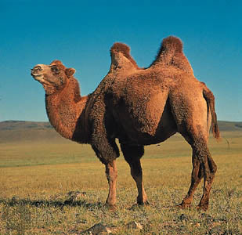
Bactrian camels were ideal caravan animals, but expeditions through the deserts were slow!
They can:
carry 600 pounds
endure extremely hot & cold temperatures
travel for long periods of time without water
go a month without food.

Slide 7
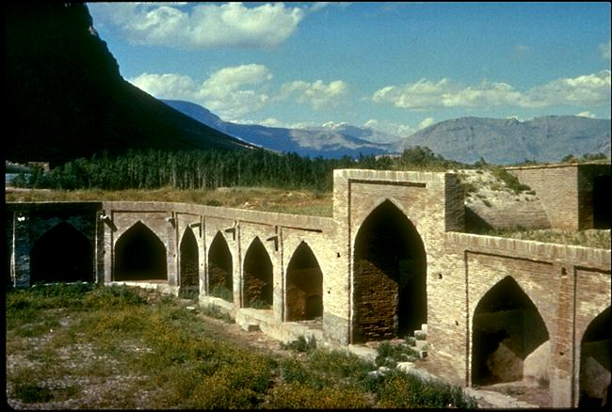
Travelling by caravan was dangerous because attacks by bandits were common!
Caravanserai like this provided shelter & rooms for storing goods.
They were often in small fortresses with guards to protect the caravans.

Slide 8
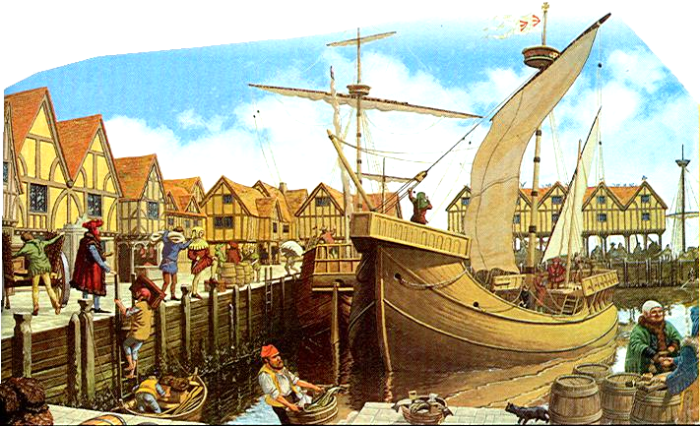
Cargo ships carried large amount of goods along parts of the trade routes.
Goods could be transporting more quickly by ship,
but sea voyages were also dangerous.
Storms, pirates, & even sea monsters were considered to be a threat.

Slide 9
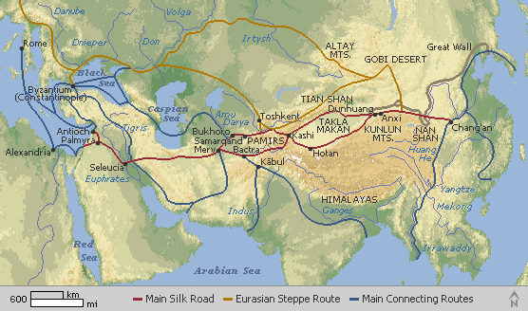
Asian goods were more expensive once they reached Europe.
Each trader traveled only part of the route and then sold his cargo to the next trader - raising the price
By the time a good reached seaports on the Mediterranean it might cost more than 100 times its original price.

Slide 10
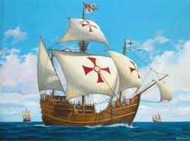
Portugal & Spain looked for alternate routes to Asia.
Land routes were:
slow
dangerous
expensive
controlled by other nations
Portugal & Spain wanted faster routes, ones they could control. So they looked to the ocean.

Slide 11
Portugal sponsored many voyages of exploration for an all-water route around Africa
The prince, Henry “the Navigator”, started a school to train sailors, ship builders, and map makers.
The southern tip
of Africa was eventually reached by a crew led by Bartholomeu Dias
in 1488
The goal of reaching India was achieved under the leadership of Vasco da Gama in 1499!

Slide 12
Spain sponsored westward voyages of exploration across the Atlantic Ocean beginning in 1492
In 1484, Christopher Columbus asked Portugal’s rulers to pay for his voyage, but he was turned down. Columbus turned to King Ferdinand and Queen Isabella of Spain, his request was approved in 1492.
,

Slide 13
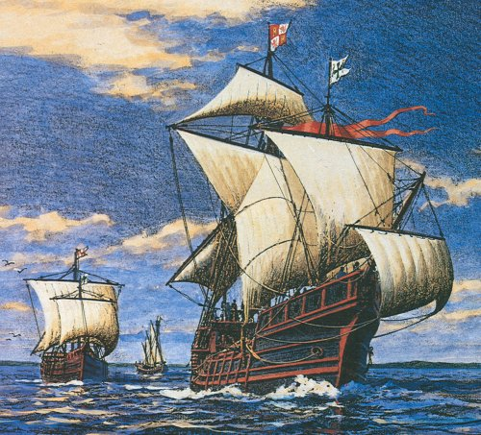
On August 3 of 1492, Columbus set sail from Palos, Spain, with three ships and 88 men.

Slide 14
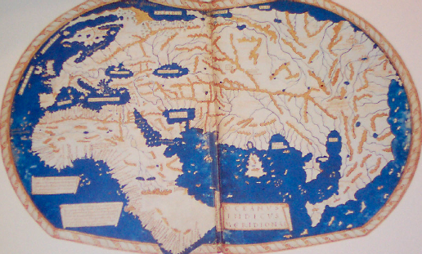
Europeans didn’t have knowledge of continents to the far west. The size of the World was thought to be much smaller.
Columbus estimated that India was 4,000 miles west of Spain.
The distance between the two is actually closer to 11,000 miles!

Slide 15
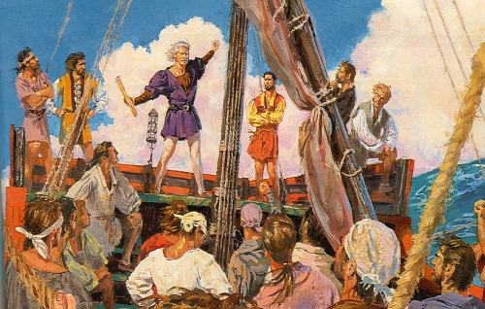
Columbus feared his crew would mutiny, but didn’t give up hope of finding a route to Asia.
On September 24, Columbus made the following entry in his journal: " I am having trouble with the crew,…complaining that they will never return home. They have said that it is insanity and suicidal on their parts to risk their lives….I am told by a few trusted men (and these are few in number!) that if I persist in going onward, the best course of action will be to throw me into the sea some night."

Slide 16
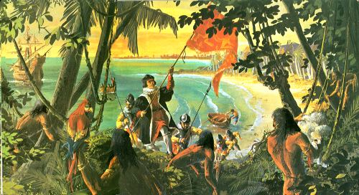
Land was sighted on October 12th!
Columbus thought he landed off the coast of Japan (Chipango) or China (Cathay).
He claimed the new land for Spain and named it San Salvador.
Columbus began his return voyage in January, 1493.

Slide 17
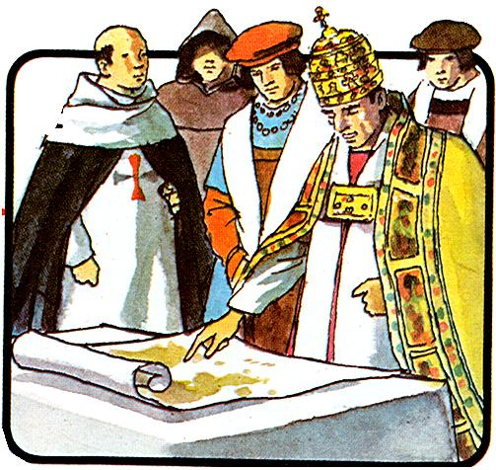
Spanish rulers were worried that Portugal would get rich from their new trade route & land.
The Spanish asked Pope Alexander VI to give them control of the sea routes and the lands Columbus had visited.

Slide 18
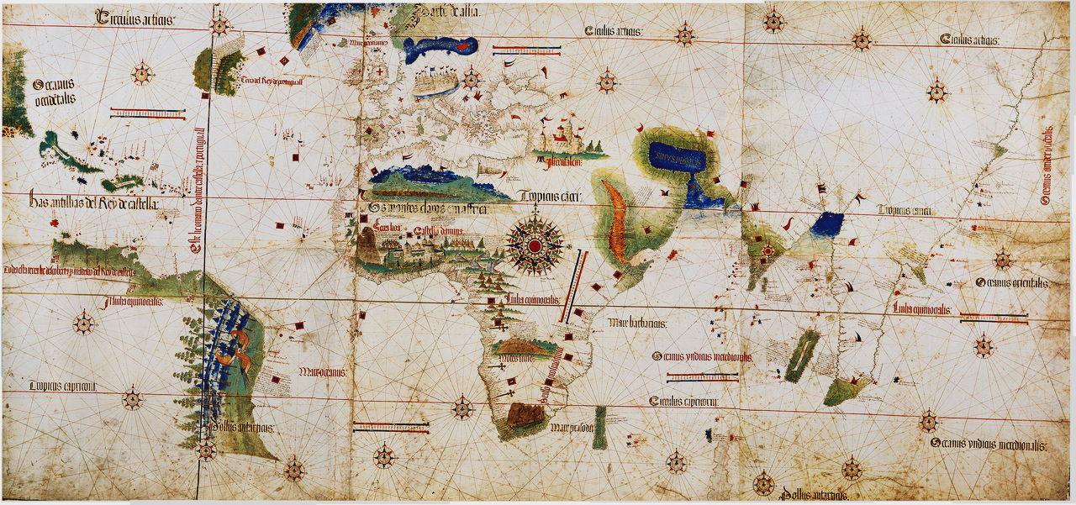
The Pope negotiated a treaty that divided land claims between Spain & Portugal
This line divided territory, according to the Treaty Of Tordesillas,.
Spain got land west of the line, Portugal got land east of the line.
EUROPE
Region believed to be Asia, based upon voyage of Columbus.
AFRICA
ASIA
Eventually other nations began exploring & claiming land too,
despite the Treaty of Tordesillas.

Slide 19
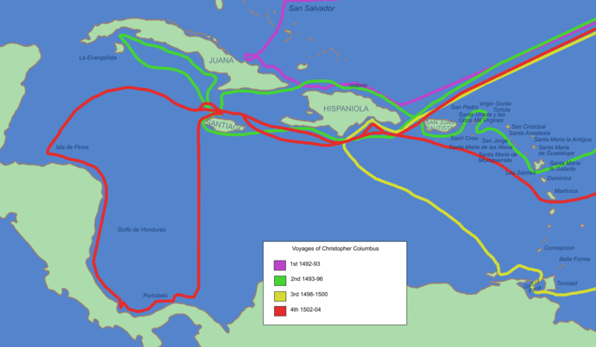
Columbus made four voyages to what he believed was Asia.
The islands reached by Columbus are known today as the West Indies
Within 30 years people knew Columbus had not discovered a westward route to India.
He died, in 1506, unaware that he had explored a “New World”, one not yet known to Europeans.

Slide 20
Citations
Illustrated Silk Road Map
ThinkQuest
http://library.thinkquest.org/13406/sr
10-31-11
Trade Route Map, Spices, Silk, Camel, and Caravanserai
Kitchen Rap BlogSpot
http://kitchenrap.blogspot.com/2011/10/silk-road-caravans-lawrence-of-arabia.html
10-31-11
3. Spices at market, Treat of Tordesillas Map, and Voyages of Columbus Map
Wikipedia
http://en.wikipedia.org
10-31-11
Gems, Gold, Camel caravan, Portuguese exploration map, Colum bus appealing to King & Queen, Columbus- Three Ships, Columbus with Crew, Columbus at San Salvador, and Pope negotiating Treaty of Tordesillas,
Mr.Carlton's 7th Grade History Class
http://www.sbceo.k12.ca.us/~vms/carlton/Renaissance/columbus1.htm
10-31-11
5. Silk Road
East Site
http://www.east-site.com/silk-road
Copyright 2004-2010
6. 1490 World Map
Cartographic-images
http://cartographic-images.net
11-1-11
Santa Maria
WWSM Toy Shop
http://www.worldwideshoppingmall.co.uk/toys/santa-maria.asp
11-1-11

